Slide 1
Monte Carlo Analysis of Two Sample T test on Movie Data
Dan Agnew, Tyler Hempstead, Mars Alkindi

Slide 2
Project Goal
Perform analysis relevant to stat 400 by using data we had scrapped from IMDB
A question of interest is whether season 2 of tv shows tend to be better or worse than season 1
One way of testing this is with a two-sample t test for difference in population means, however we would be violating the assumption that our two samples are independent
Use Monte Carlo analysis to determine the effectiveness of a two-sample t test for a difference in population means between season 1 and season 2 of tv shows when different assumptions are applied

Slide 3
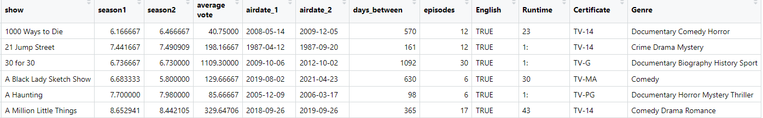
Data
226 observations of season 1 and season 2 data on TV shows
Data Sampled from top 5000 most voted on TV shows on IMDB

Slide 4
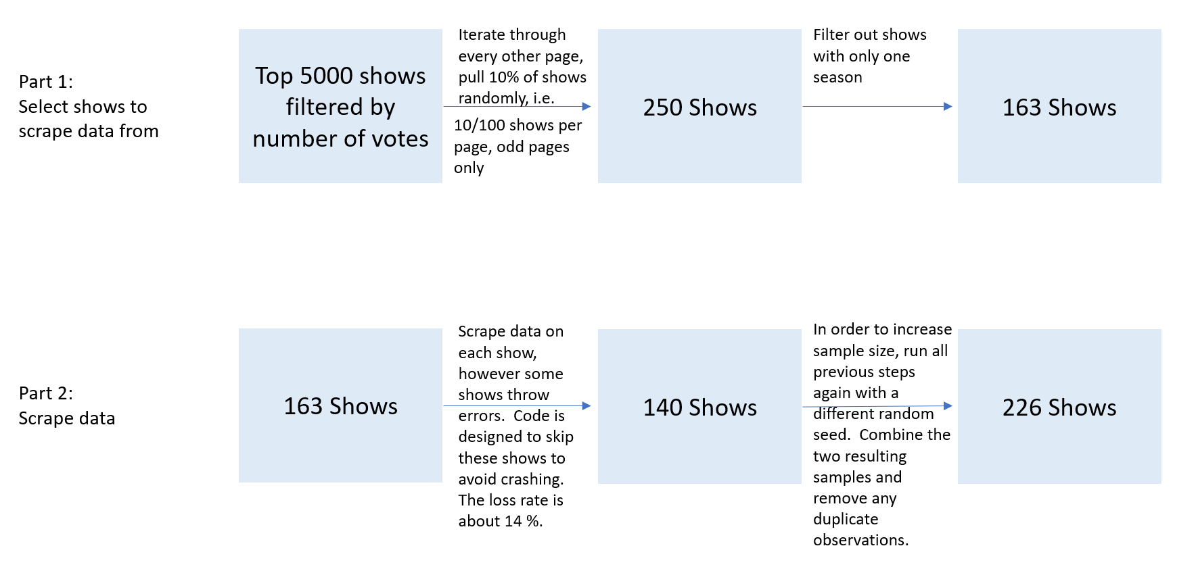

Slide 5
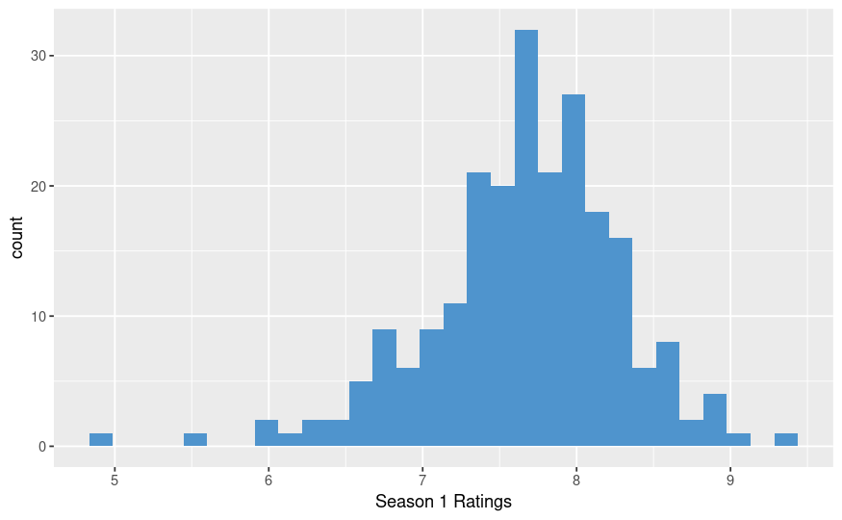
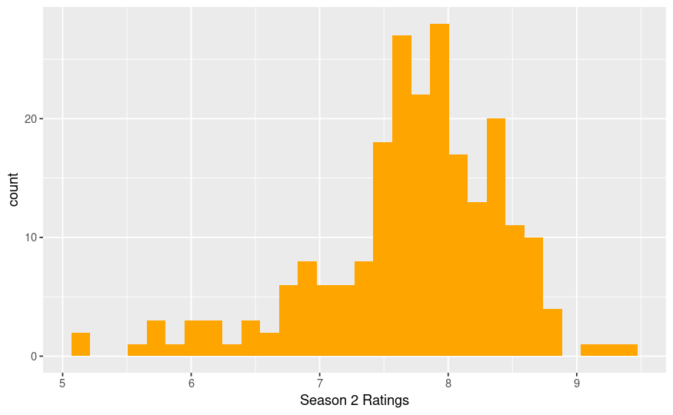
Exploratory Analysis

Slide 6
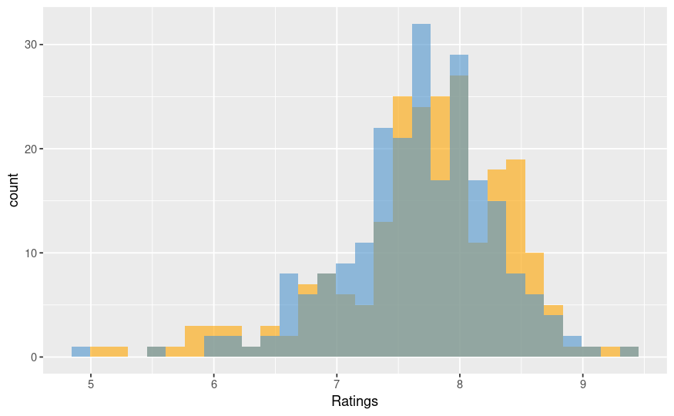
Exploratory Analysis Cont.
Season 1
Mean: 7.67
SD: .627
Season 2
Mean: 7.71
SD: .725

Slide 7
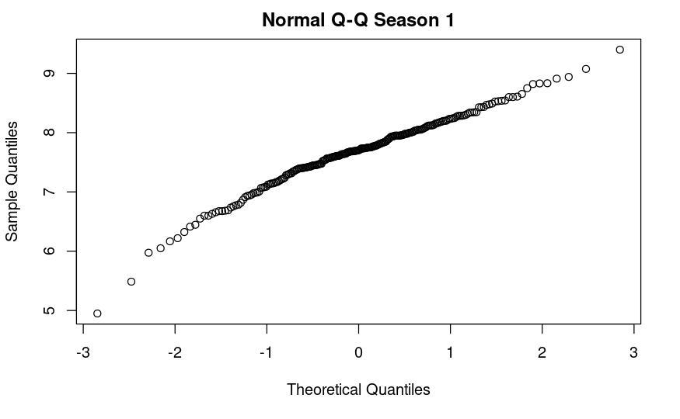
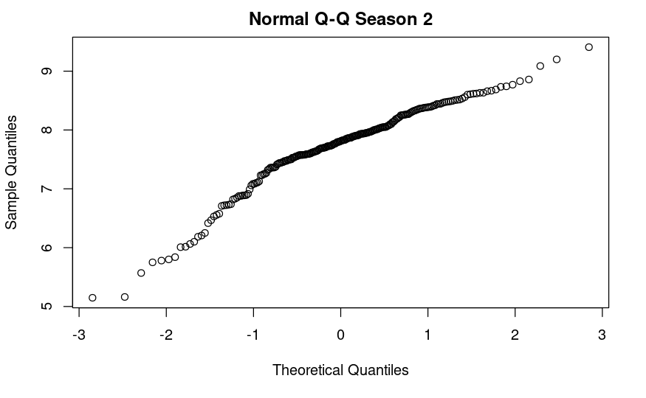
Exploratory Analysis Cont.
Normal Quantile-Quantile plots are not perfectly linear. It is probably acceptable for our data to vary from the normal
distribution to this extent, however we are still violating the normality assumption for two-sample T test somewhat.

Slide 8
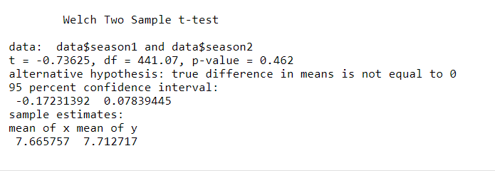
Two-Sample T Test Results
We do not find statistically Significant evidence of a difference in population mean rating between first and second seasons of tv shows.
It could be worth trying to run this analysis again in the future if we have a larger pool of data than 226 observations.

